Slide 1
Clare Smith
Vice President and Chief Financial Officer

Slide 2
What is Simplicity?
A new healthcare financial benefit that makes managing healthcare expenses easier for members.
SimplicitySelect: An online payment manager which facilitates financial obligation clarity across all provider claims - both in and out of network
All SimplicitySelect members can use the convenient Simplicity payment portal to view claims and pay, as desired
SimplicityComplete: A healthcare financing mechanism which prepays co-insurance and deductibles for eligible members for a consolidated payment experience
SimplicityComplete members receive one monthly statement from Simplicity and no longer need to pay separate in-network provider bills; functions like a credit card
Members can receive 12 months of interest free payments (minimum monthly payment $50)

Slide 3
1.7M
Americans filed
for bankruptcy in
2013 due to unpaid medical bills
37%
increase in total employee cost for health care expenses from 2010-2015
)
43%
of privately insured Americans have High Deductible Health Plans (HDHP)
Sources: Mercer L.L.C Health Care Cost Survey, 2014; NerdWallet Health, Meta-analysis of data from the U.S. Census, Centers for Disease Control, the federal court system and the Commonwealth Fund, 2013;
Notes:
- high deductible: 2014 data; growing – in 2009 was 22% (16% growth in 5 years)

Slide 4
So, what does this mean for the customer?
Everyday medical expenses can be challenging.
A major medical event can be catastrophic.
Consumers need a safety net.
Notes:
- historically insurance has reduced financial risk with unexpected health crisis
- insurance still protects consumers from unexpected health crisis
- today, however, shift to HDP has made “every day” medical expenses financially difficult for many employees
- even with ACA cap on max OOP – the impact on a $6,850 OOP max on an employee who makes $32,000 a year can be devastating

Slide 6
Simplicity Pilot
CoreSource kicked off a Simplicity pilot in Sept 2015 with 5 groups and ~3,000 members
“If you’re not at least a little embarrassed by your first product release…..you’ve released too late”
- Reid Hoffman, Founder of Linked-In
Pilot was successful as we learned a lot
We have made Simplicity better

Slide 7
Developing our Value Proposition
What we thought…
What we realized…
“Ease & Convenience”
One size fits all
Consolidated provider bill sufficient for simplifying payment process
Easy → Consumers Pay Bills
“Trust & Advocacy”
Members want options
More comprehensive approach to simplifying healthcare billing and payment process
Clarity → Consumers Pay Bills

Slide 8
Simplicity Value Proposition
Trust and Advocacy for the Member
Confused? We’re here to help!
Simple Bill Payment Process and Rewards
One Bill for SimplicityComplete users
“Simple Rewards”
Control and Transparency
Easy to understand statements & portal
Notes:
Here are three key improvements that will be made to Simplicity.
- Not done:
- we continue work on ideas for Simplicity
- we understand its difficult to bring everyone along in the development process, however, we have made the decision to be transparent and share where we are
- we will continue to update you as we continue to evolve
- positive outcome of the delayed roll out to the inforce block – CoreSource will have longer exclusivity
- we continue work on ideas for Simplicity
- we understand its difficult to bring everyone along in the development process, however, we have made the decision to be transparent and share where we are
- we will continue to update you as we continue to evolve
- positive outcome of the delayed roll out to the inforce block – CoreSource will have longer exclusivity
- still talk about convenience and flexibility, but really message needs to be around advocacy and trust
- in consumers eye, whole health care billing process is complex, confusing and inaccurate
- know from our stats – claims we adjudicated are 99.7% accurate – both our QA and adjustment rates tell us this
- however, we consistently heard from consumers: my bill is wrong
- perception does not equal reality
- made us realize the real value we can provide to consumers is assurance: we will pay it correctly and if it is wrong, we will fix it
- we need to change consumer’s comfort level: when you get your EOB – we have done everything possible to get you the lowest price we could; its OK to pay now
- need to set expectations with messaging and follow through with more education and touch points
- responsible roll out
- we are going to take a longer term view on Simplicity
- we will take the time in 2016 to develop and support the best Simplicity product we can to maximize impact in 2017 and beyond
- we realize we need more Beta testing
- will talk about second beta details later on

Slide 9
Summary Benefits to Members
Control
Advocacy
Empowerment
Protection

Slide 10
Summary SimplicitySelect Benefits
Easily view and pay for all outstanding Provider bills in one place
Payment flexibility - who, when, how much - using any method desired
Ability to access and download important documents and reports
Control
More easily identify billing inaccuracies via online portal
Online platforms enables members to get questions answered quickly
Better understanding of charges and obligations due to simplified format and explanations
Empowerment

Slide 11
Summary SimplicityComplete Benefits
Dedicated customer service to solve billing issues and discrepancies with member interests in mind
Consolidated Provider bills into a familiar and consumer-centric format
Periodic healthcare and financial benefit education and updates
Advocacy
Financial safety net for high deductible health plans
Ability to extend payments, as needed
Help when “your benefits become your obligations”
Protection

Slide 12
Providers Want SimplicityComplete*
96%
Provider
Acceptance
Providers Accepting Simplicity:
3,473
Provider Opt-Outs: 158
91%
of Simplicity Participating Providers have accepted multiple payments
*2.9% fee taken for complete payment service
Actual CoreSource Pilot Results

Slide 13
SimplicitySelect Portal

Slide 15
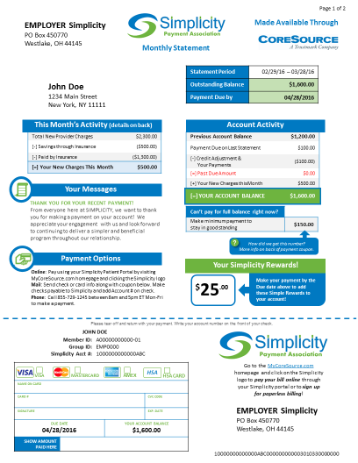
SimplicityComplete Statement

Slide 16
Benefits for Brokers
CoreSource and Simplicity are Differentiator for Broker
CoreSource is leading the introduction of this benefit to the self-insured market
Exclusivity with ECHO for Simplicity
Innovative online payment manager and healthcare financial benefit concept
Improves member experience for their client
No cost to client
Funded via Complete Pay fee from Provider
No work on Broker behalf

Slide 17
Benefits for Groups
New innovative healthcare financial benefit to offer to employees
Help employees pay for medical services when costs become excessive
Ability to educate employees re: HSA, HDHP and Simplicity
Makes HSA plans more beneficial to employees
Know Providers will not ask for advance payment from employees
Very low effort to implement
Sign one page Amendment to PSA
CoreSource can assist with member communications when provided with employee email addresses

Slide 18
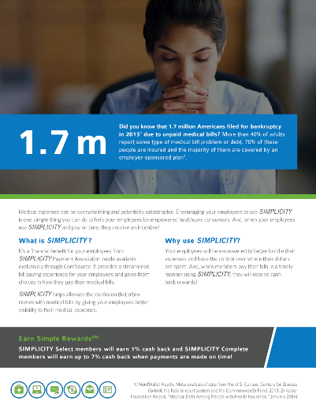
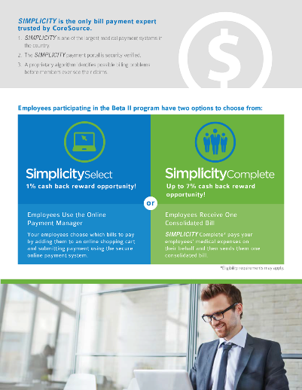
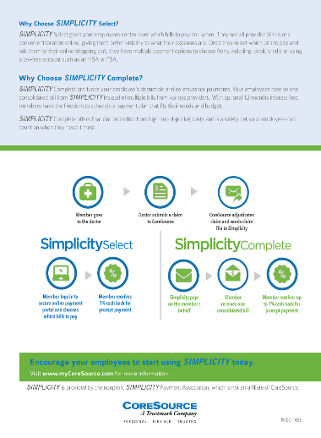
Employer Communications
Goal: Educate employers before communicating to their employees
Messaging: Benefits of SimplicitySelect and SimplicityComplete
Call to action: Promote Simplicity to employees
Collateral: 4-page brochure, HTMLs, poster, table tent, online toolkit

Slide 19
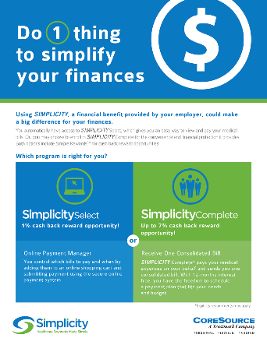
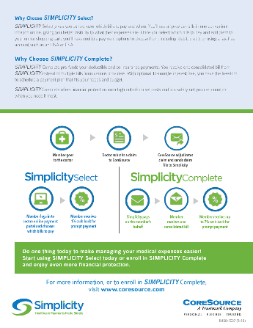
Member Communications
Promotional Marketing
Flyer
Series of HTMLs
Videos
Portal messaging
Welcome kit
Additional Communications
ID card letter
Portal registration/electronic communication
FAQs

Slide 20
Sample Client Rollout Timeline
-60
-45
-30
0
+30
+60
Client and Broker Conversations
Program
Timing
Communications
PSA
New ID Cards Issued
Start Prefunding
Member Claims under Complete;
Claims added to Select Online Payment Portal
First
Statement
Due
Member
ID Card Activation; members choose to upgrade to Complete
First Statement Issued
Member Pre and Post Launch Communications

Slide 21
Service & Support
CoreSource focuses on healthcare plans
Plan Support | Answer general questions about how program works Answer medical plan-related questions
Financial Support | Administer payments and member balances Statement and balance-related questions Process member and provider dis-enrollments
Simplicity handles member financial support questions for PCI compliance reasons

Slide 22
Next Steps
Rolling out a second pilot in Q3 2016
Continue learnings from Pilot
Rolling out to CoreSource Block and New Business in 2017

Slide 23
Your Benefits. Your Money. Your Way.

